Slide 1
Manufacturing Analysis for Clothing Industry
Using Excel, Tableau, Power BI & SQL
GROUP 6

Slide 2

AGENDA
Introduction
Project Objective
Data Analysis
Key Findings
Advantages & Disadvantages of Clothing Industry
Market Factors affecting clothing Industry
Conclusion

Slide 3

INTRODUCTION
Clothing manufacturing industry is one of the largest global sectors.
Highly competitive and influenced by trends.
Data-driven decisions are essential to reduce inefficiencies and improve productivity.

Slide 4

PROJECT OBJECTIVE
Analyze production, rejection, and cost data.
Identify inefficiencies and provide actionable insights.
Tools used: Excel, Tableau, Power BI & SQL

Slide 5
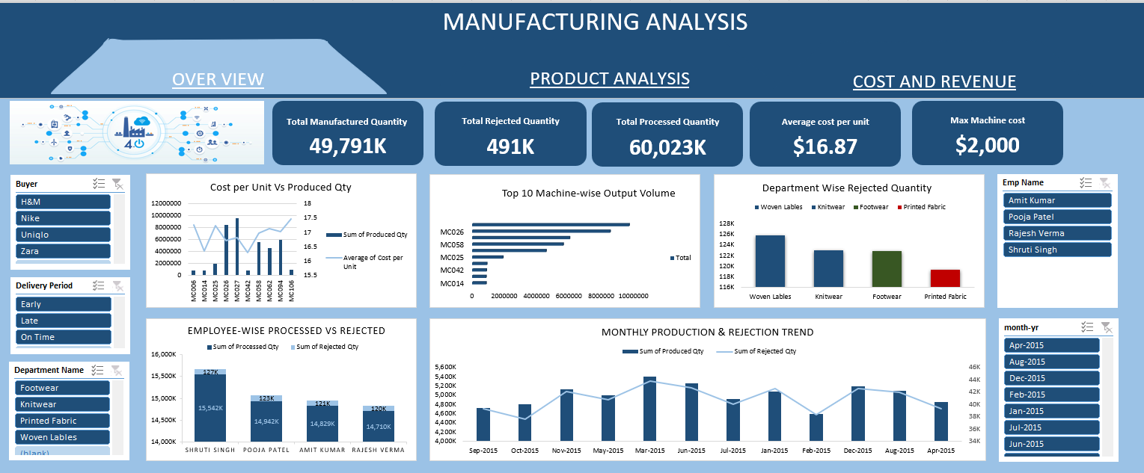
EXCEL DASHBOARD ANALYSIS

Slide 6
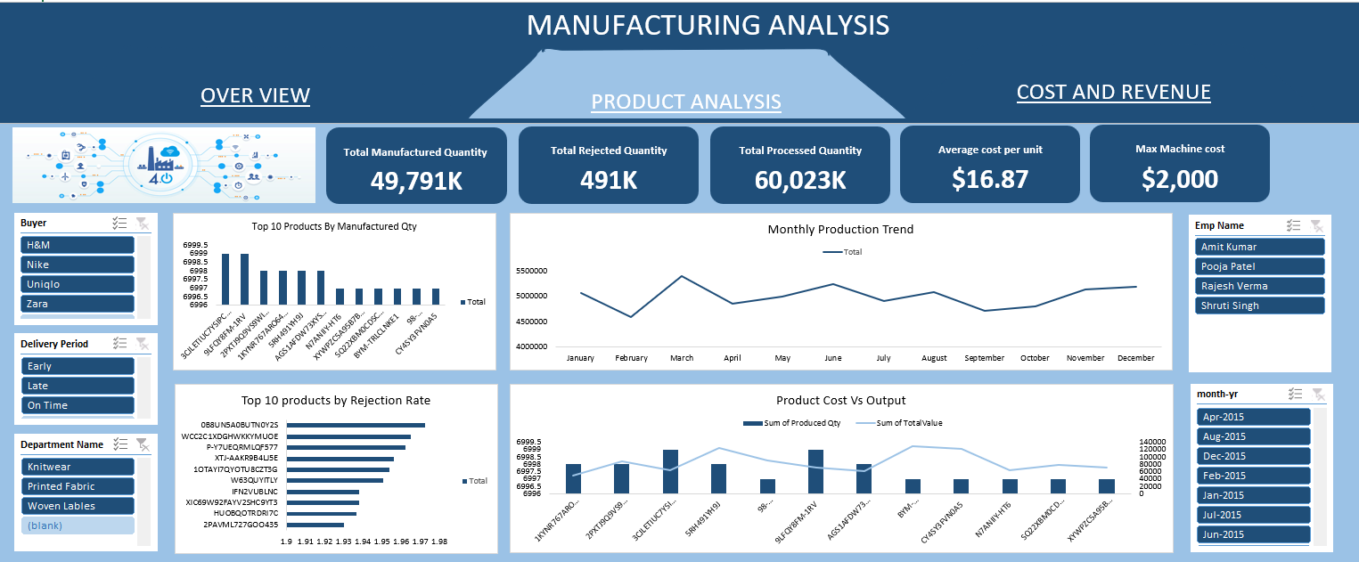
EXCEL DASHBOARD ANALYSIS

Slide 7
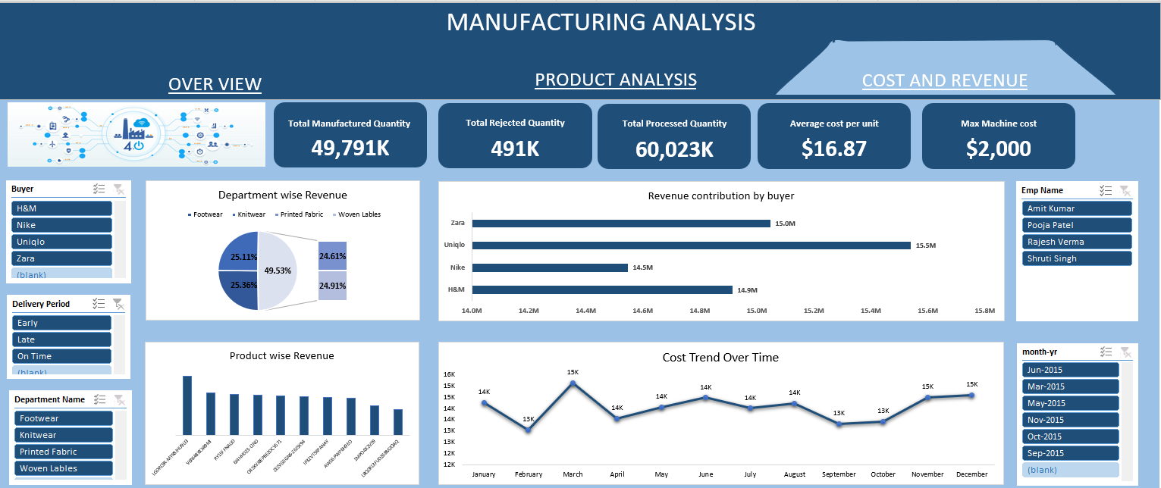
EXCEL DASHBOARD ANALYSIS

Slide 8
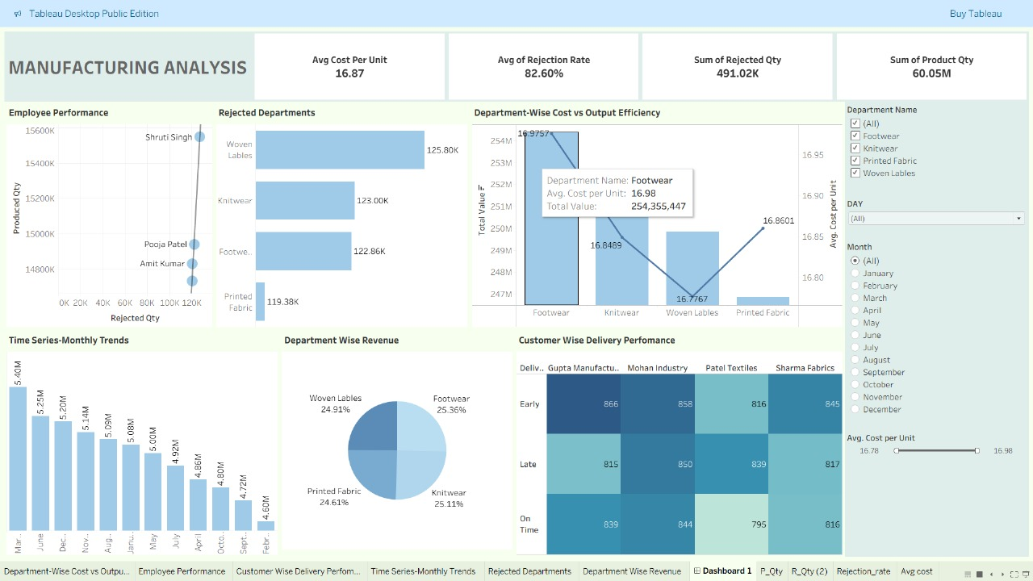
TABLEAU DASHBOARD ANALYSIS

Slide 9
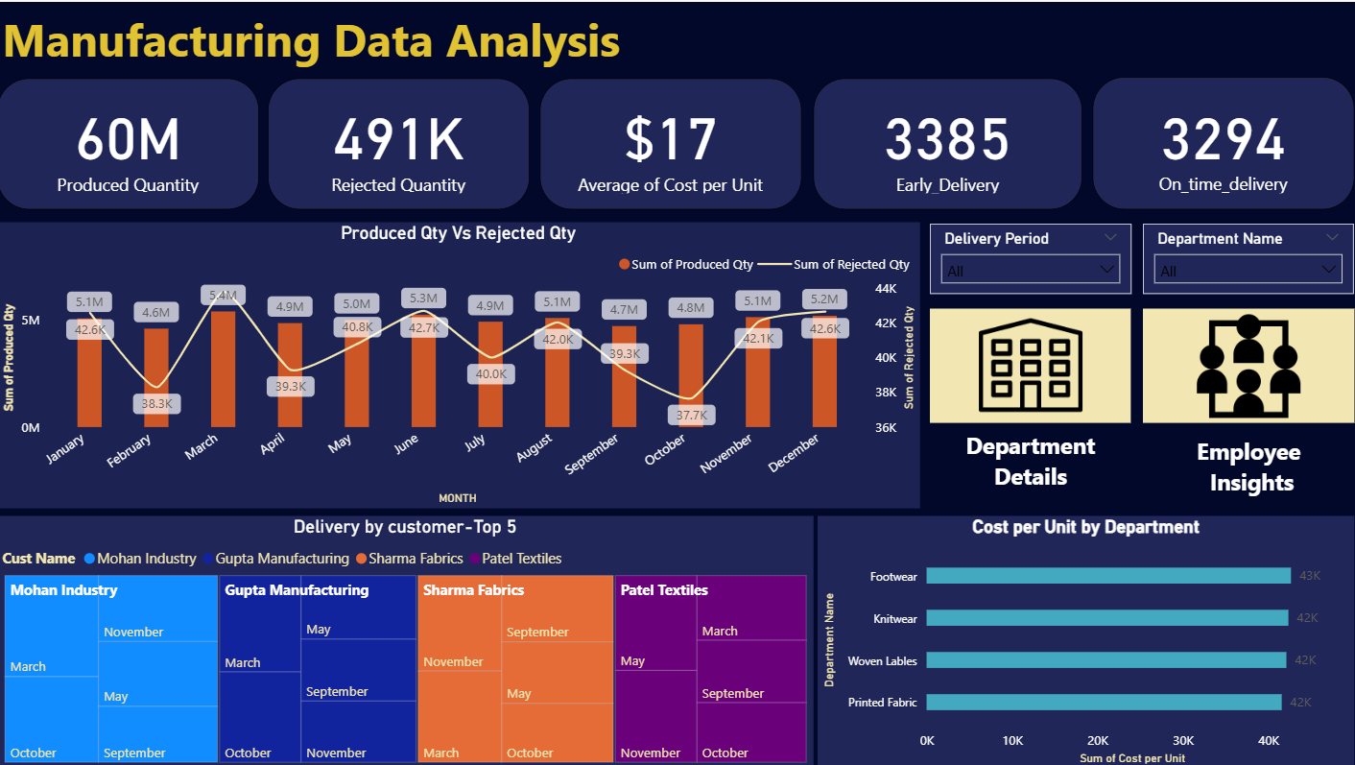
POWER BI DASHBOARD ANALYSIS

Slide 10
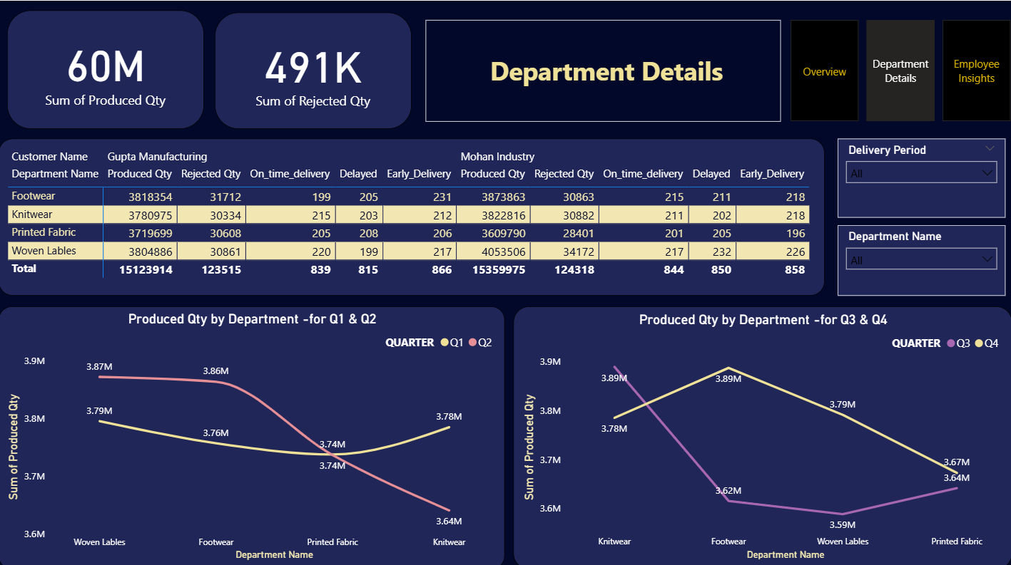
POWER BI DASHBOARD ANALYSIS

Slide 11
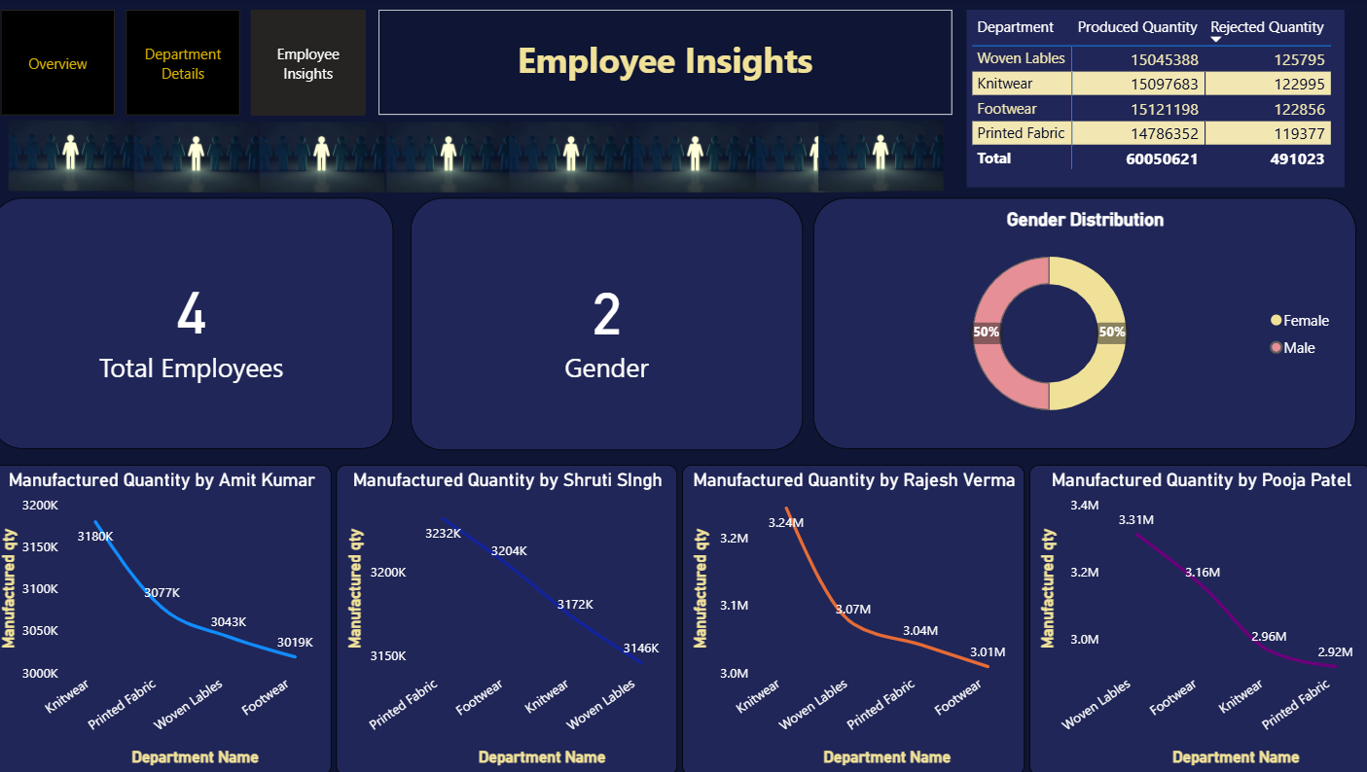
POWER BI DASHBOARD ANALYSIS

Slide 12

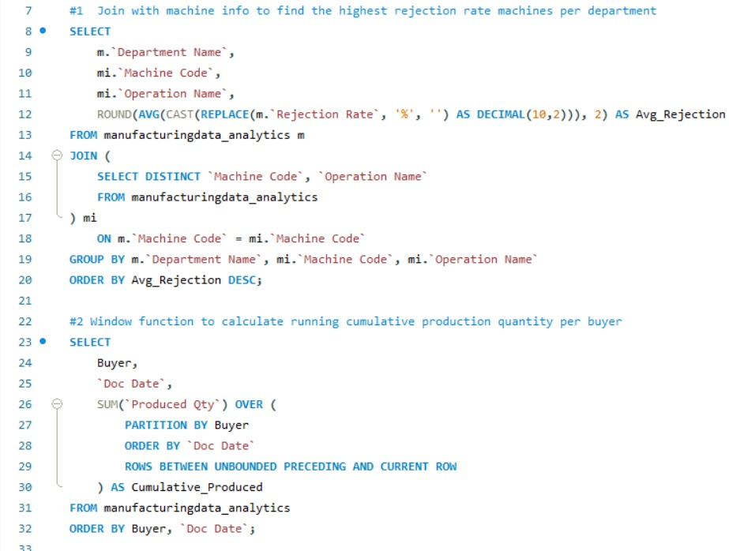
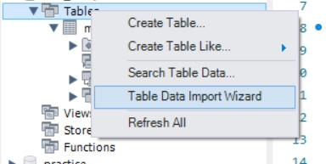
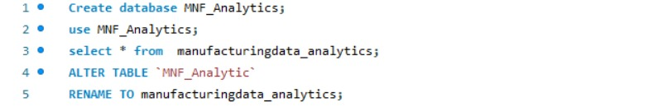
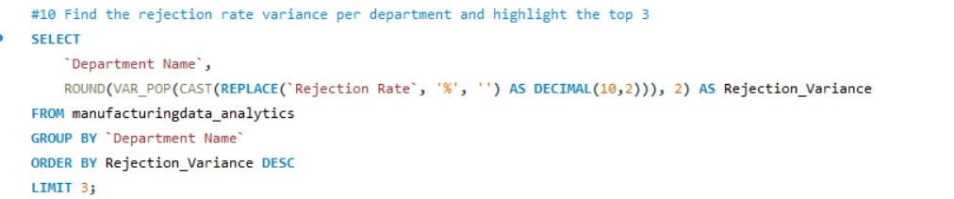
SQL DATA ANALYSIS

Slide 13
KEY FINDINGS
Footwear and Printed Fabric show highest rejection rates.
Certain employees have consistently higher output.
Top 10 machines contribute to major output.
Seasonal variation in production and rejection.

Slide 14

ADVANTAGES & DISADVANTAGES OF CLOTHING INDUSTRY
Advantages:
High global demand.
Export opportunities.
Job creation.
Disadvantages:
Seasonal demand fluctuations.
High competition.
Rising raw material costs.

Slide 15

MARKET FACTORS AFFECTING CLOTHING INDUSTRY
Raw material price volatility.
Changing fashion trends.
Economic conditions.
Labor cost and availability. `

Slide 16

CONCLUSION
Reduce rejection through improved quality control.
Employee training to boost productivity.
Monitor cost trends for better forecasting.
Use predictive analytics for demand planning.

Slide 17
THANK YOU

